Slide 1
CAPSTONE PROJECT FOR SQL
Mentor name: jaya pandey
Student name: sindupriya itha

Slide 2
Contents
INTRODUCTION
DATA ANALYSIS USING SQL
INTERPRETATIONS
CONCLUSION

Slide 3
Introduction
In an era where digital content is king and customer preferences are constantly evolving, understanding the intricacies of movie rental trends is crucial for both the entertainment industry and businesses that rely on this dynamic market.
SQL, a powerful data querying language, can unveil invaluable insights from movie rental data. It helps to not only present data but also to extract meaningful stories and trends that inform decision-making, optimize inventory, and enhance customer experiences.

Slide 4
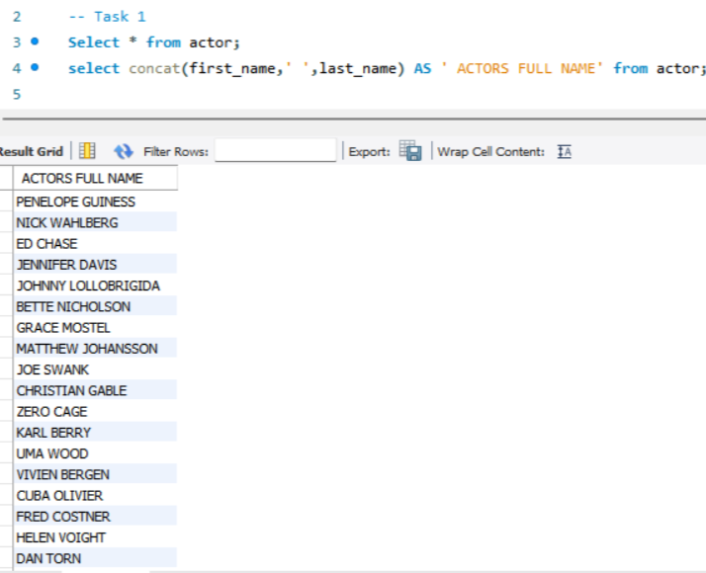
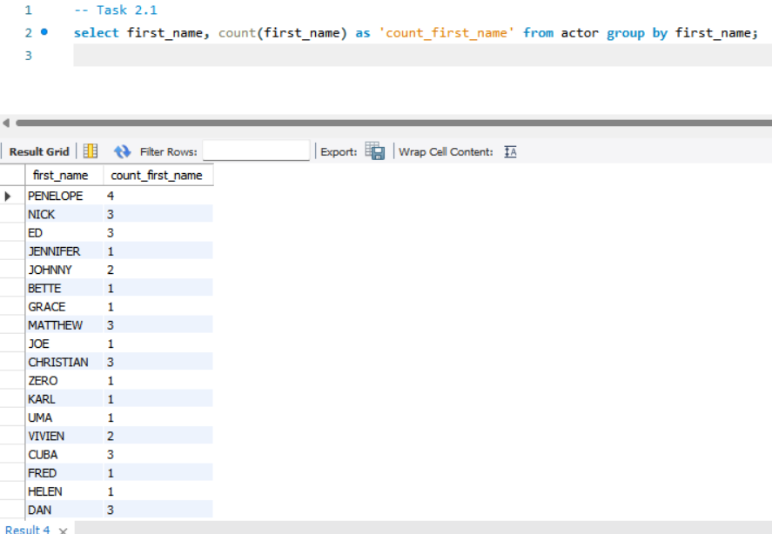
Data analysis using sql
TABLE NAME : For task 1 actor table is used.
COLUMN NAME : First name and last name has been used.
TECHNIQUES : To join the two columns I have used concatenate function
INTERPRETATION : This columns shows full name of the actors.
TABLE NAME : For task 2.1 actor table is used.
COLUMN NAME : First name has been used.
TECHNIQUES : count aggregation, group by and having clause.
INTERPRETATION :. shows the count of first name

Slide 5
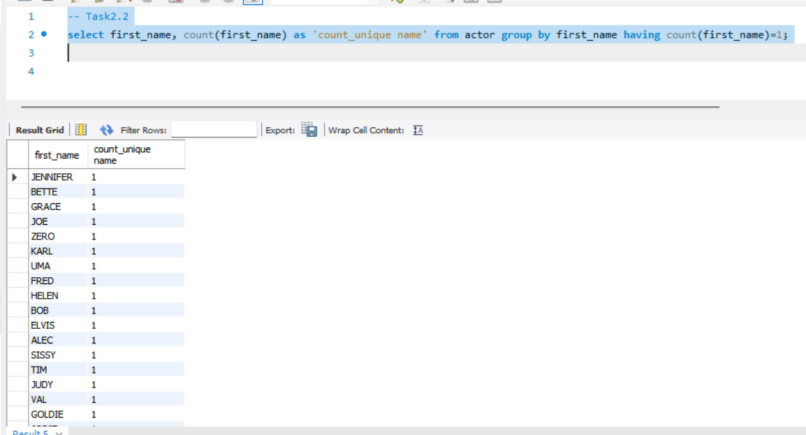
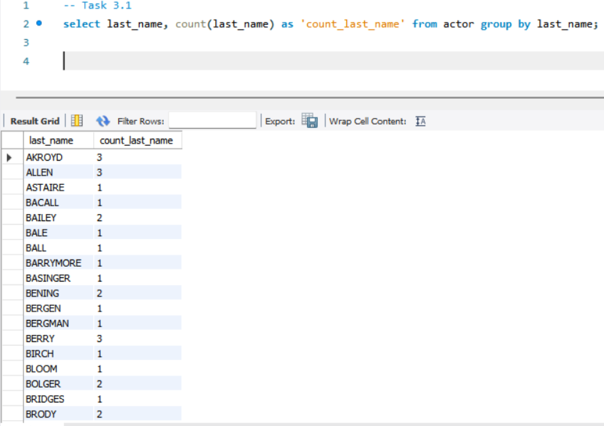
TABLE NAME : Actor table is used.
COLUMN NAME : First name has been used.
TECHNIQUES : count aggregation, group by and having clause.
INTERPRETATION : shows the first name who having count 1
TABLE NAME : Actor table is used.
COLUMN NAME : Last name has been used.
TECHNIQUES : aggregation, group by and having clause.
INTERPRETATION : Shows the count of last name.

Slide 6
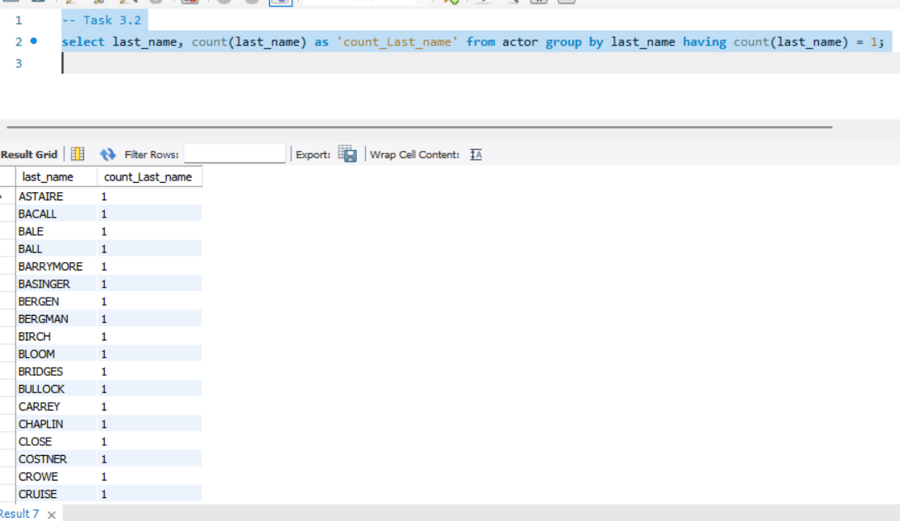
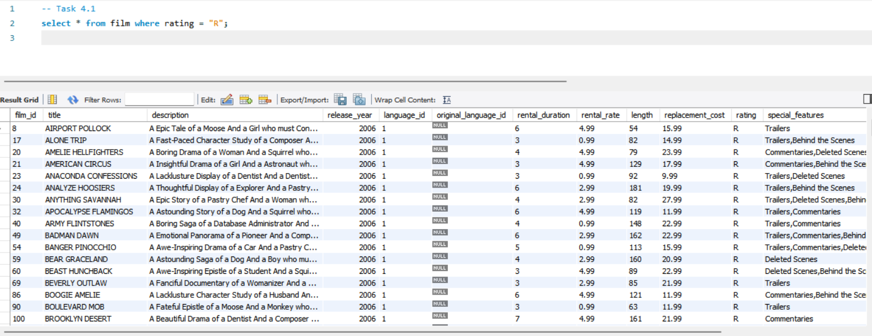
TABLE NAME : Actor table is used.
COLUMN NAME : Last name has been used.
TECHNIQUES : count aggregation, group by and having clause.
INTERPRETATION : shows the last name who having count 1.
TABLE NAME : Film table is used.
COLUMN NAME : Rating Column has been used.
TECHNIQUES : where clause and equalsto has been used.
INTERPRETATION : shows the rating = R.

Slide 7
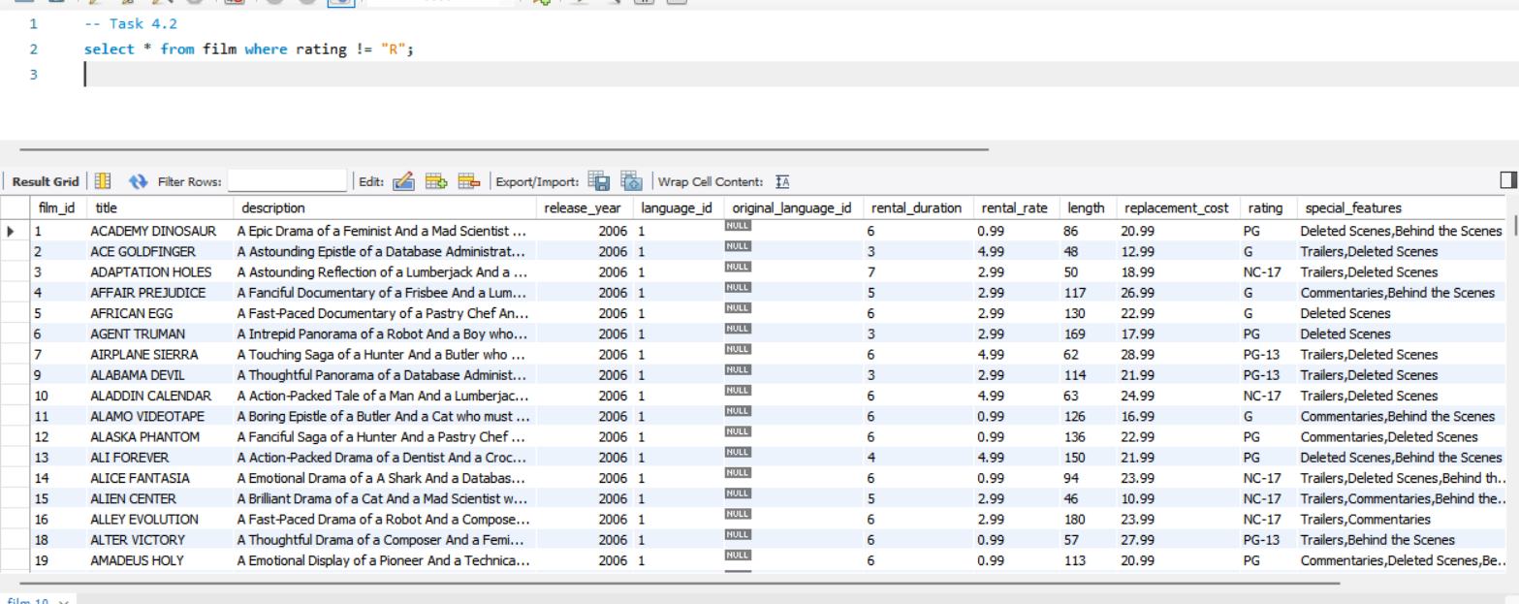
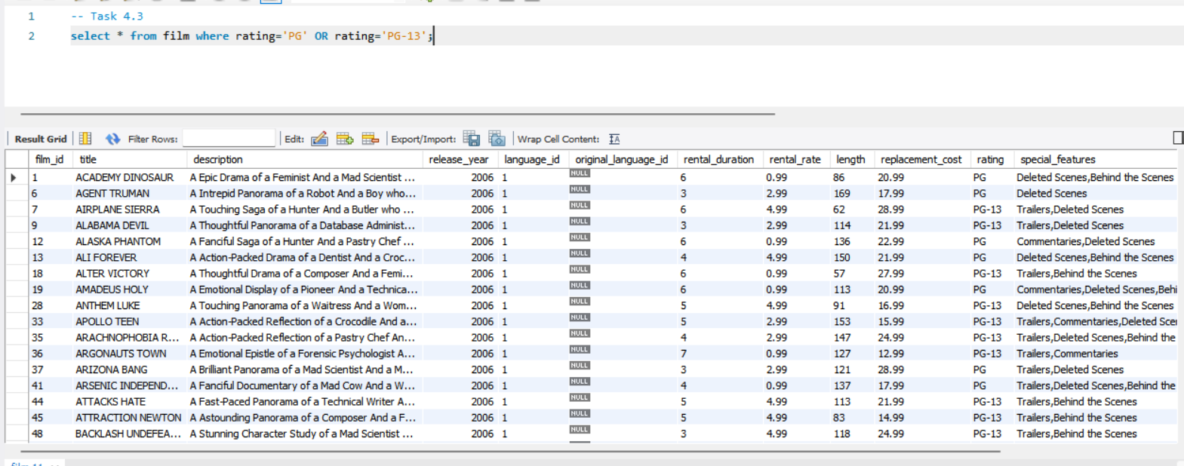
TABLE NAME : film table is used.
COLUMN NAME : rating column has been used.
TECHNIQUES : where clause and not has been used.
INTERPRETATION : shows not rating = R.
TABLE NAME : film table is used.
COLUMN NAME : rating has been used.
TECHNIQUES : where clause and ‘or’ logical operator has been used.
INTERPRETATION : shows both PG OR PG – 13.

Slide 8
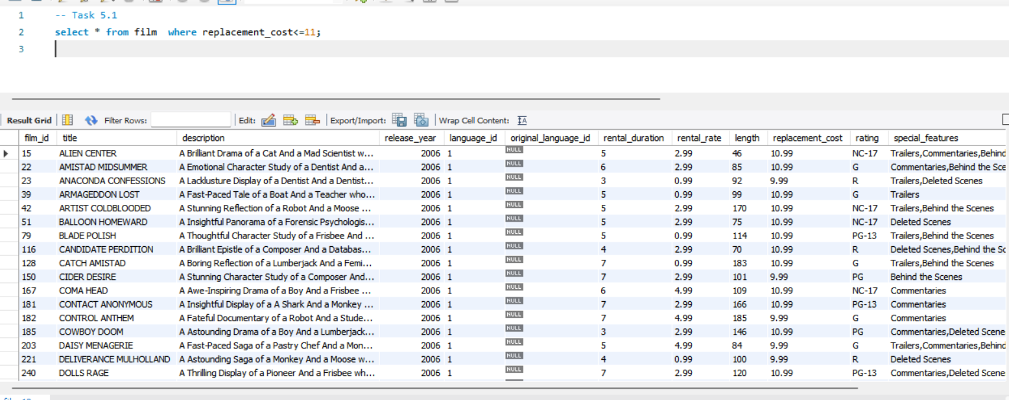
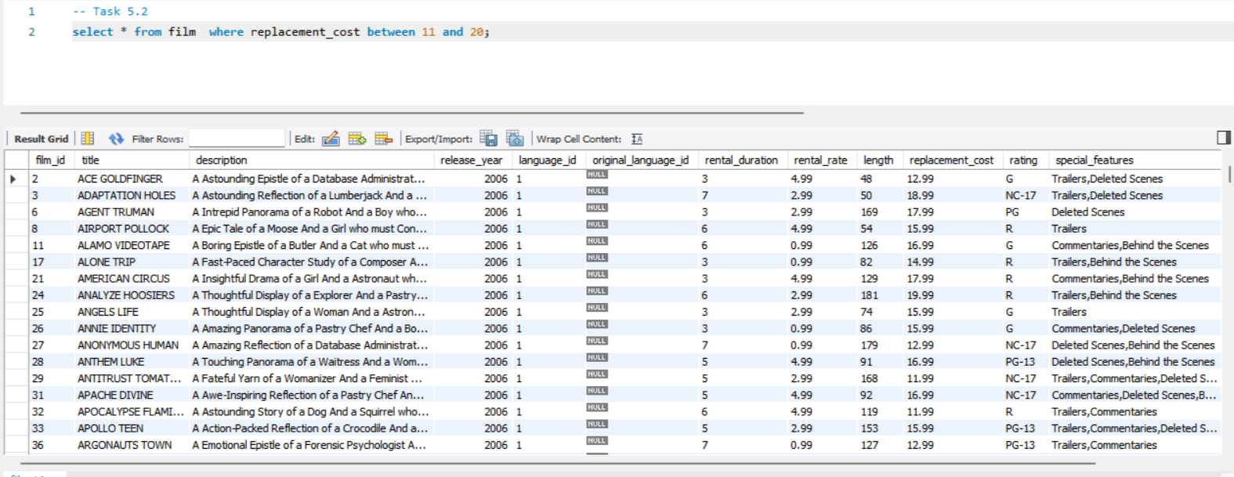
TABLE NAME : film table is used.
COLUMN NAME : replacement cost has been used.
TECHNIQUES : where and less tha nor equal to operator has been used.
INTERPRETATION : shows the replacement cost <= 11.
TABLE NAME : film table is used.
COLUMN NAME :replacement cost has been used.
TECHNIQUES : where clause and between has been used.
INTERPRETATION : shows the replacement cost between 11 and 20.

Slide 9
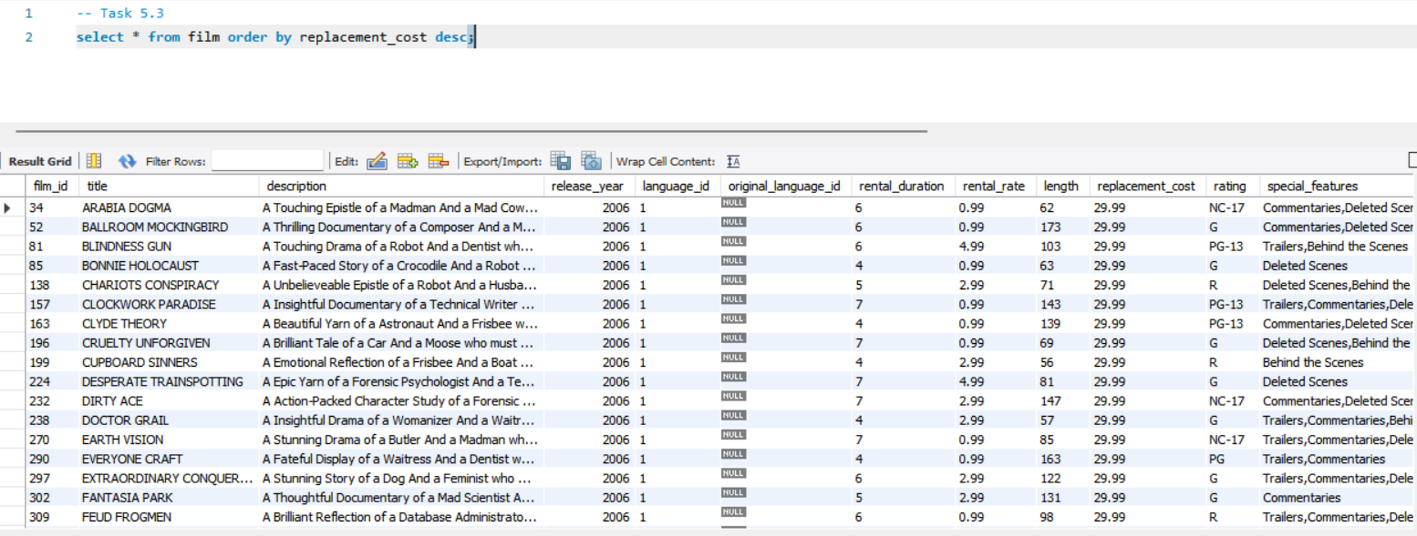
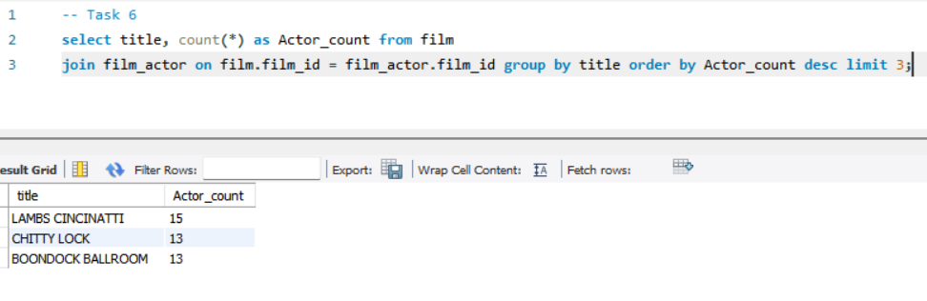
TABLE NAME : film table is used.
COLUMN NAME : replacement cost has been used.
TECHNIQUES : Here order by clause and descending has been used.
INTERPRETATION : shows the title and replacement cost in descending order.
TABLE NAME : film table is used.
COLUMN NAME : title has been used.
TECHNIQUES : I have used join on ,group by ,order by and descending limit
INTERPRETATION : shows the title ,sort in descending order and count of actor limit till 3.

Slide 10
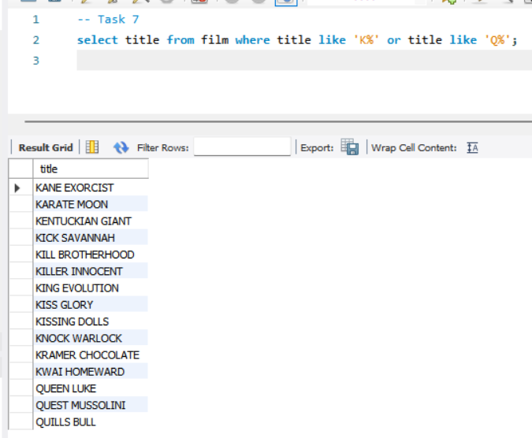
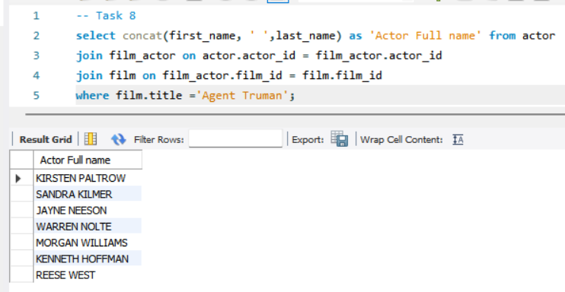
TABLE NAME : film table is used.
COLUMN NAME : title has been used.
TECHNIQUES : I have used where clause ,like ,’or’ operator.
INTERPRETATION : shows the title starting from the letter K OR Q.
TABLE NAME : Actor and film table is used.
COLUMN NAME : first and last name ,title has been used.
TECHNIQUES : concatenate function ,where and join on clause is used.
INTERPRETATION : shows actors full name for the title agent truman.

Slide 11
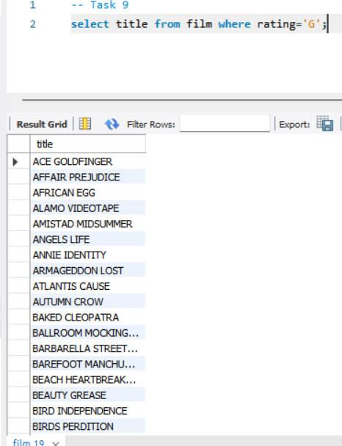
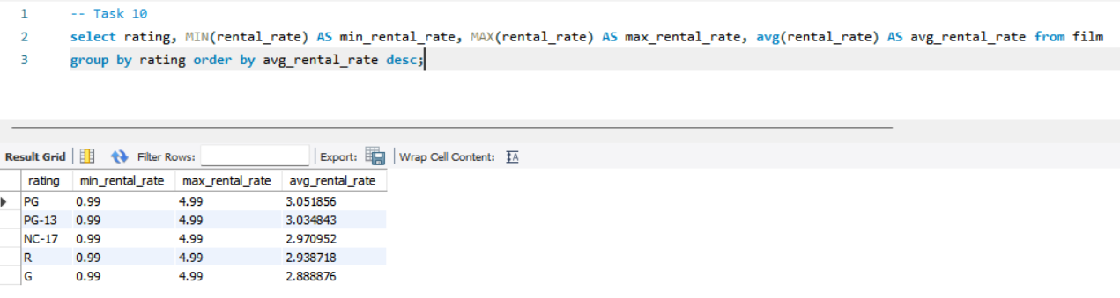
TABLE NAME : film table is used.
COLUMN NAME : title has been used.
TECHNIQUES : I have used where and equals to is used.
INTERPRETATION : shows the title for the rating = G.
TABLE NAME : film table is used.
COLUMN NAME : rating ,title ,rental rate has been used.
TECHNIQUES : I have used maximum, minimum ,average, group by, order by clause and descending order
INTERPRETATION : shows maximum ,minimum average of rental rate in descending order.

Slide 12
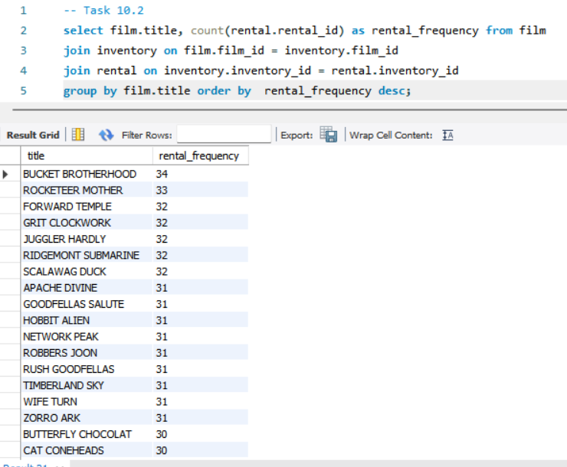
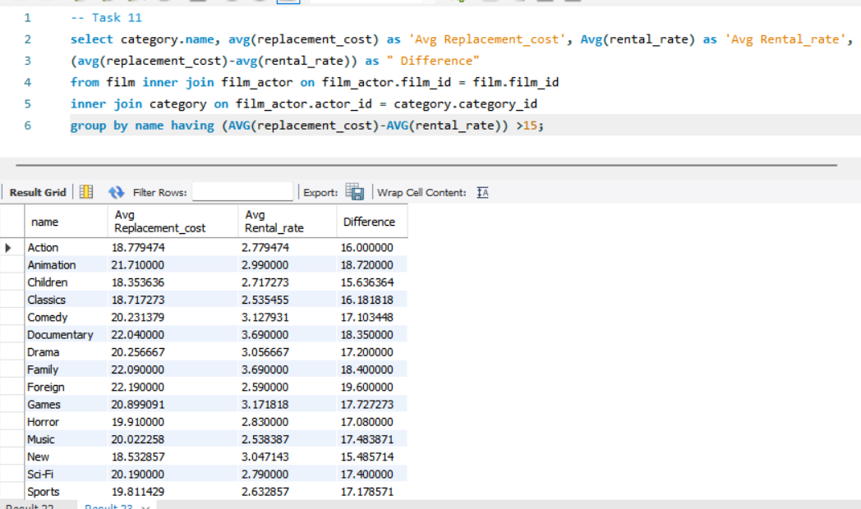
TABLE NAME : film table is used.
COLUMN NAME : title ,rental frequency has been used.
TECHNIQUES : I have used count aggregate function, join on group by, order by clause, descending order
INTERPRETATION : shows the count of rental id as rental frequency in descending order
TABLE NAME : film table is used.
COLUMN NAME : rental rate ,replacement cost has been used.
TECHNIQUES : I have used average aggregate function ,group by ,having, on clause and join.
INTERPRETATION : shows the average rental rate and replacement cost and their difference and displays the category name accordingly.

Slide 13
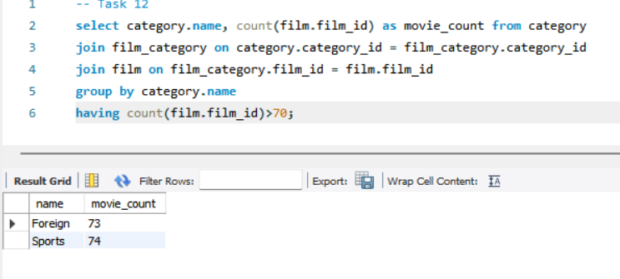
TABLE NAME : category table is used.
COLUMN NAME : name ,film id has been used.
TECHNIQUES : I have used count aggregate function ,group by ,having, on clause and join.
INTERPRETATION : shows the count of movie for this specific category name.

Slide 14
CONCLUSION
Based on my understanding on the dataset, here is a brief conclusion:
The dataset contains a varied set of Actors, with their own unique first and last names.
It filters and displays movies with an "R" rating and those without an "R" rating leveraging audience and marketing team to make decisions according.
Listing movie titles and their replacement costs aids in managing renting the movies.
movie titles sorted in descending order and limits the list to the top 3 actors for each movie helps in marketing strategies
movies showing with titles starting with either "K" or "Q.“ helps consumers and markets to fetch the movies easily
Presence of Specific titles contain with ‘K’ or ‘Q’ and movies with a "G" rating helps in marketing and retriving specific movies
maximum, minimum, and average rental rates of movies helps in calculating sales.
count of rental frequency helps in managing inventory and sales

Slide 15


